Slide 1

10 Opinions For More Maintainable .NET Apps
scottsauber
Slides at scottsauber.com

Slide 2











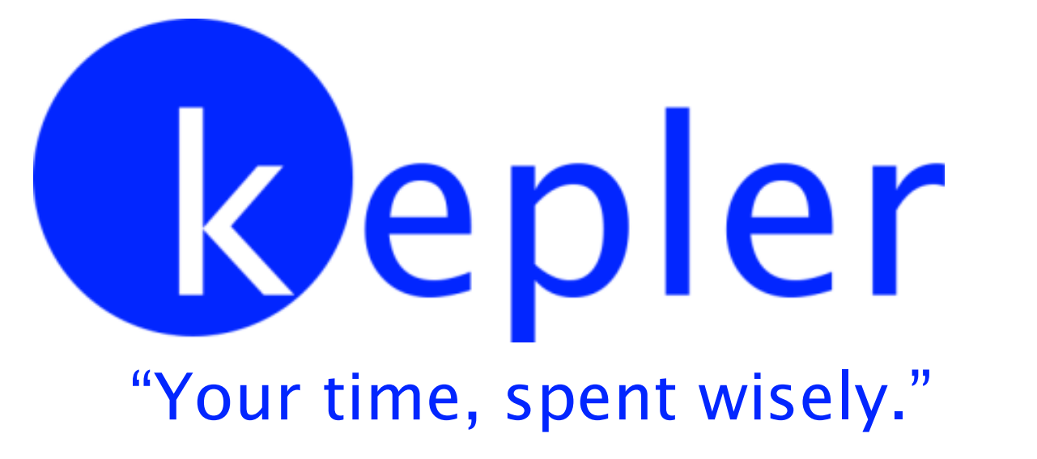

Thank you to our Sponsors!

Slide 3
Audience
.NET Developers
Interested in more maintainable apps
Hopefully that Venn Diagram is pretty much just a circle

Slide 4
Agenda
Series of lightning talks
Better folder structure
Treat Warnings As Errors
Logging “Best Practices”
Global Authorize Attribute via FallbackPolicy
Use FluentValidation
Remove Server Header
Don’t use IOptions… use this one weird trick instead…👀
Version endpoint
Code Smells
HTTP Security Headers
#11, #12, #13
Rapid fire Bonus!

Slide 5
Goals
Exposure to new ideas
Takeaway some ideas back to work

Slide 6



Who am I?
Director of Engineering at Lean TECHniques
Microsoft MVP
Co-organizer of Iowa .NET User Group
Redgate Community Ambassador
Dometrain Author
Blog at scottsauber.com

Slide 7
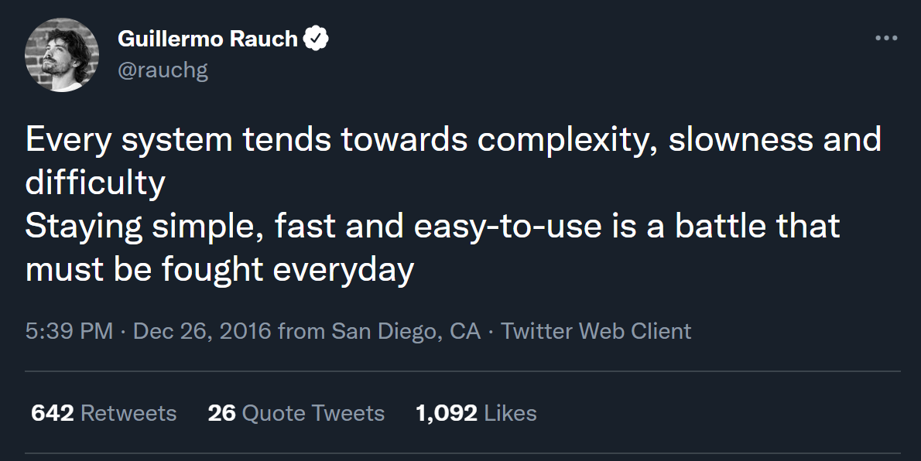

Slide 8

Folder Structure

Slide 9
Problem: OOB MVC Folders By Responsibility
All of these live in their own separate folders and most are required to add a new feature
Controllers
Views
Models
wwwroot/css
wwwroot/js
Adds navigation friction
Scope of a feature is scattered
Makes it hard to add, delete or extend existing features

Slide 10
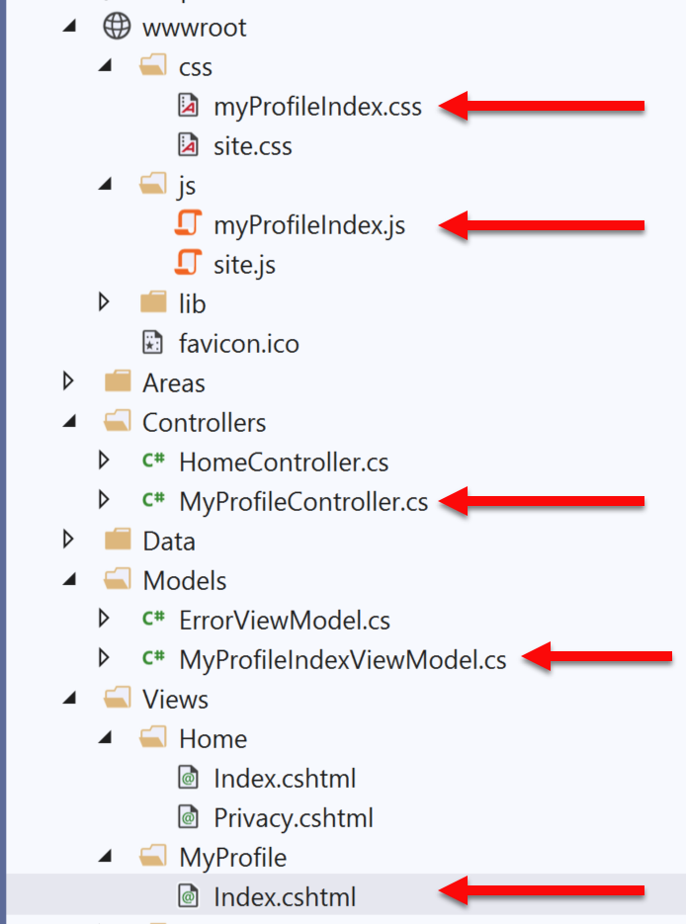
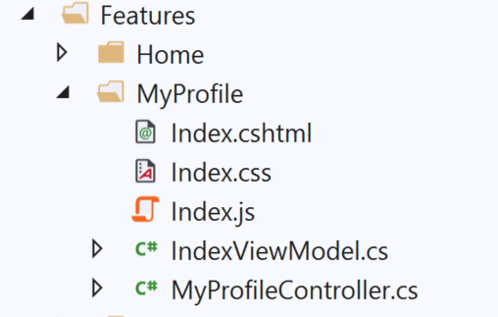
Solution: Use Feature Folders
Grouping by Feature, not by Responsibility, results in easier maintenance
Related things remain together (High Cohesion)
MVC out of the box:
Feature Folders:

Slide 11
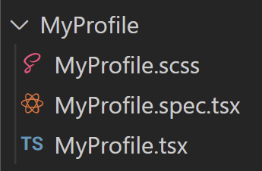
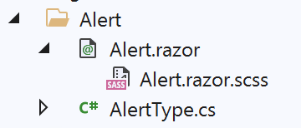

Solution: Use Feature Folders
React:
Blazor:
scottsauber
Notes:
Some even put tests in their feature folders

Slide 12
But mah layers!!!1one
I used to do horizontal csproj’s
.Data, .Business, .Common, .Models, .Api
Now I just do two projects
.Core and .Api (or .Web or .Console or whatever entrypoint is)
I slice the folders here vertically too
Slice horizontally only if you publishing packages to NuGet or internally

Slide 13
Feature Folder Extra Resources
Soap analogy
How to do this in ASP.NET Core
My blog post
Steve Smith’s Blog on Feature Folders vs. Areas
Refactoring to Vertical Slice architecture (featureFolders++)
Derek Comartin
scottsauber

Slide 14
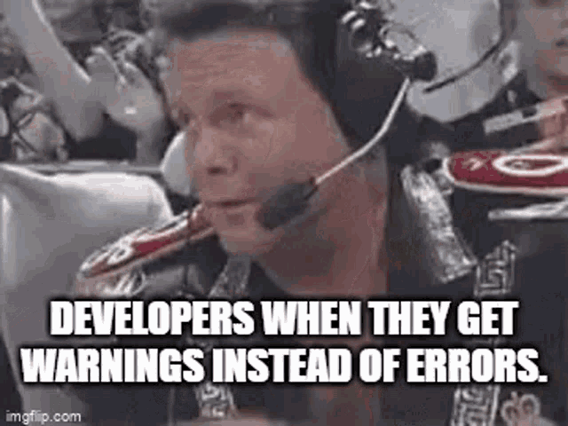
⚠️ == ❌

Slide 15
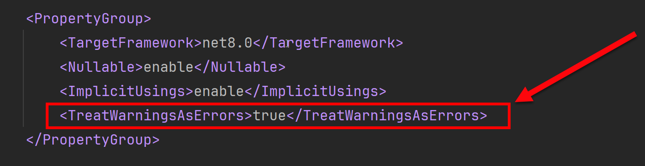
Treat Warnings as Errors
Build/Compiler warnings don’t exist in my world
Error or Nothing
scottsauber

Slide 16

Logging “Best Practices”

Slide 17
Logging “Best Practices”
Use Serilog as logging framework
Use ILogger everywhere, not Serilog directly
Use structured logging, not concatenation
But… Azure Log Analytics workspaces cap at 500 columns
Each log should have key bits of information on it
User ID, Correlation ID, Request URL, App Version, etc.
“We need to log that”
Logs vs Metrics vs Audits

Slide 18
Logs
Developer focused
Example: log an exception or log response from external API
Log Levels
Debug vs Information vs Warning vs Error vs Critical
Stop abusing Information! You probably meant Debug
How long does my log store keep logs?
How reliable is my log delivery system
It’s okay to not have 100% guaranteed delivery of logs
How does Serilog work?

Slide 19
Metrics
Two types
Application
CPU, Network, Response Times, Queue Depth, etc.
Business
How many times did someone click that button
How long do we need to keep Metric data?
It may or may not be acceptable to miss some data
What data store are we using?

Slide 20
Audits
Recording who, did what, and when in your application
Usually for legal, compliance, or traceability reasons
Losing any data is unacceptable
Store audits with the same data store as the data that’s being audited

Slide 21

Global Authorize Attribute via FallbackPolicy

Slide 22
Problem: Security is Opt-In
You have to remember to add a [Authorize] attribute everywhere
Or you have to remember to inherit from a custom BaseController
You forget? Oops you’re wide open to the world!

Slide 23
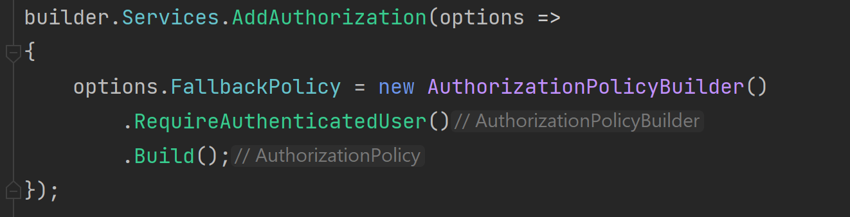
Solution: FallbackPolicy
A Fallback Policy is the policy that gets evaluated if no other policy is specified

Slide 24

Validation

Slide 25
Validation – What’s wrong with Data Annotations
Only work well for simple scenarios
Hard to make custom ones
Hard to unit test
Separate annotations for each property
Can get “tall”
SRP violated
Model + Validation combined into one class
scottsauber

Slide 26

Solution: Use FluentValidation
Fluent interface
Business rules are easy to maintain and read
Easy to show a stakeholder
Easy to test
Integrates with ModelState.IsValid
372M downloads
https://github.com/JeremySkinner/FluentValidation
scottsauber

Slide 27
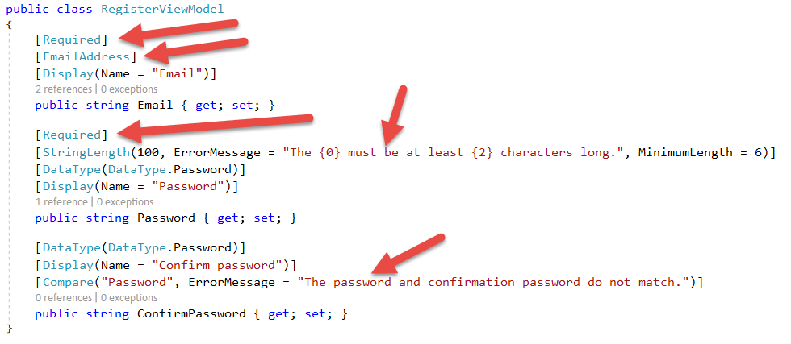
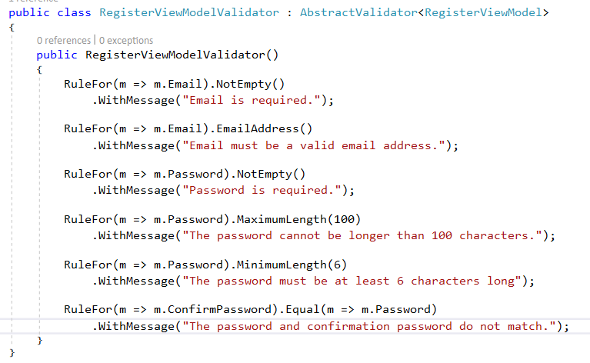
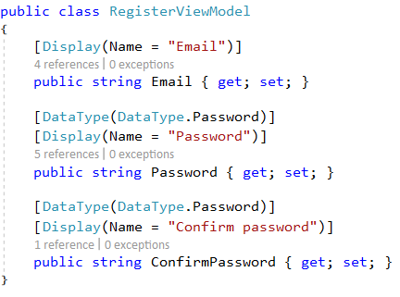
Template Code:
Refactored with Fluent Validation:

Slide 28
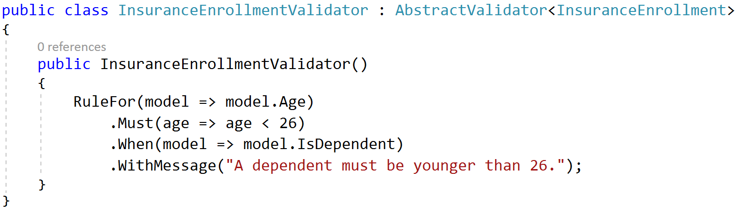
A Rule that only exists if….

Slide 29

Remove the Server Header

Slide 30
Remove the Server Header
By default ASP.NET Core adds a “Server Header”
This says “Kestrel”
This exposes to black hats what you’re running
Focuses exploiting known CVEs

Slide 31
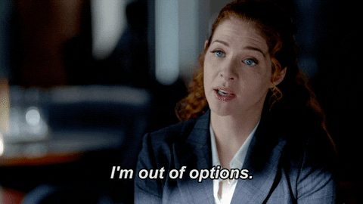
Don’t use IOptions…

Slide 32
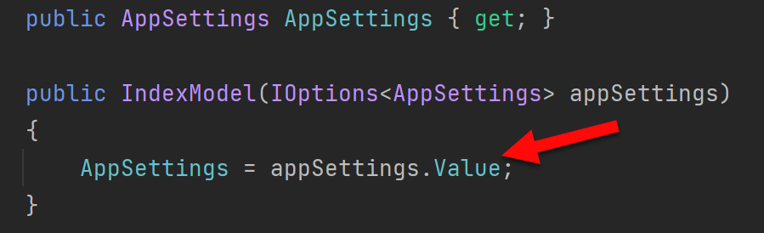
Problem: IOptions is annoying
Dependency on Microsoft.Extensions.Options down in other csproj’s
Testing IOptions is slightly annoying with Options.Create()
.Value everywhere adds friction
scottsauber

Slide 33
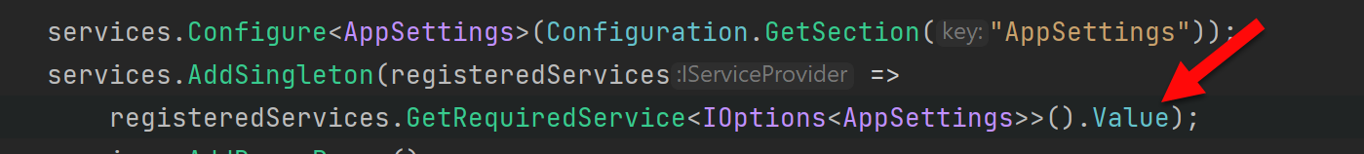
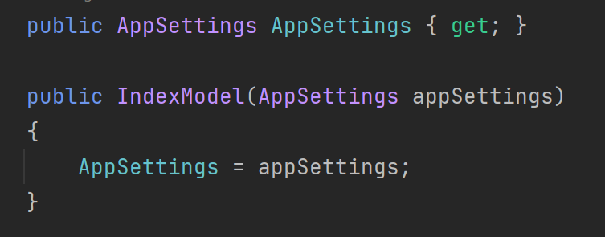
Solution: Register your Options class directly
scottsauber

Slide 34

Version Endpoint

Slide 35
Version Endpoint
Versioning the API, right? Nope!
What version of your app are you running?
/api/version
Format:
<Date>.<BuildNumber>.<ShortGitSha>
20240815.1452.abc1234
Generate version in CI and set SourceRevisionId on publish
Useful while creating a CI/CD pipeline
Version goes on every log
Bonus: notify SPA of new deployment for reload purposes
scottsauber

Slide 36
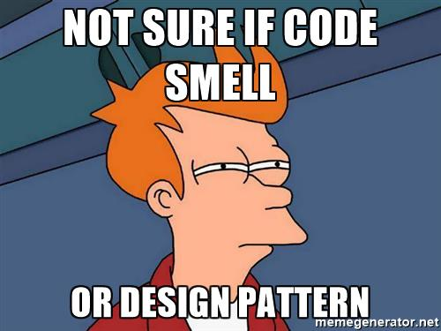
Code Smells

Slide 37
Structuring a method
Happy Path always at the bottom of the method
Don’t want to scan for “what happens when all goes well” and find it in the middle of a method
Use return’s instead of nested if => else
scottsauber

Slide 38
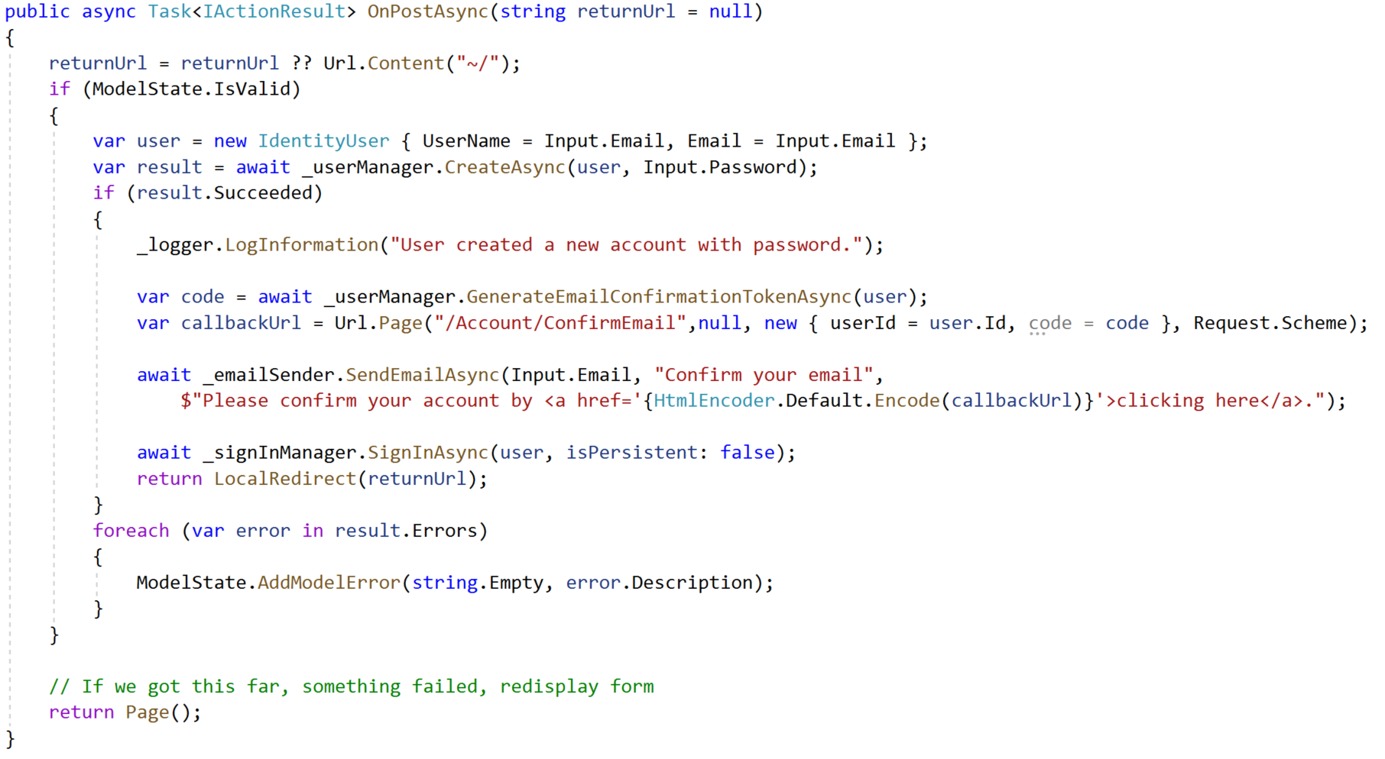
Razor Pages Template Code:

Slide 39
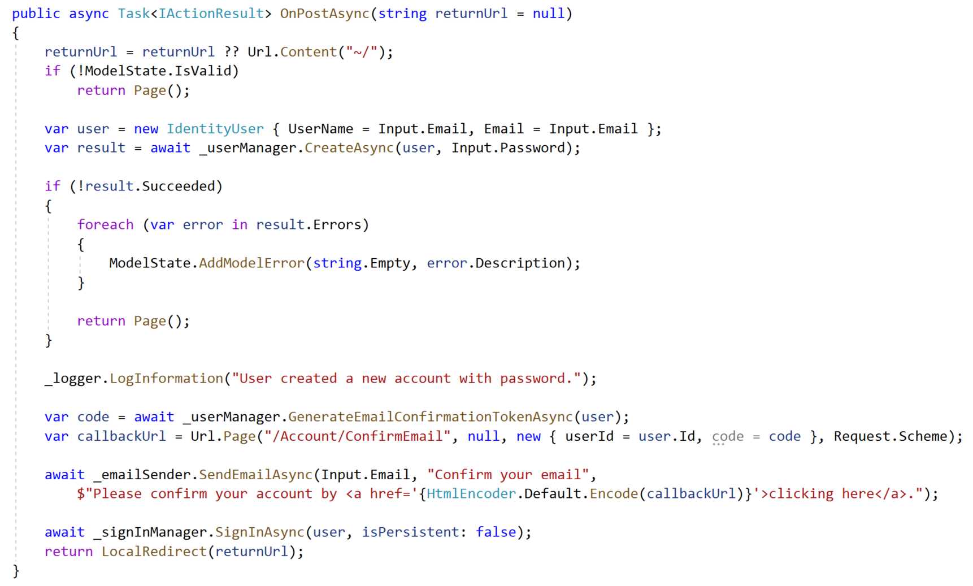
Refactored with Happy Path At The Bottom:

Slide 40
The Indentation Proclamation
The more indented your code is, the harder it is to follow
Nested if’s, nested loops, etc.
…I made this up
scottsauber

Slide 41

Code smells
Not hard and fast rules, just my “warning light”
Methods > 20 lines
Classes > 200 lines
Regions
You probably should’ve added a new class or method instead

Slide 42
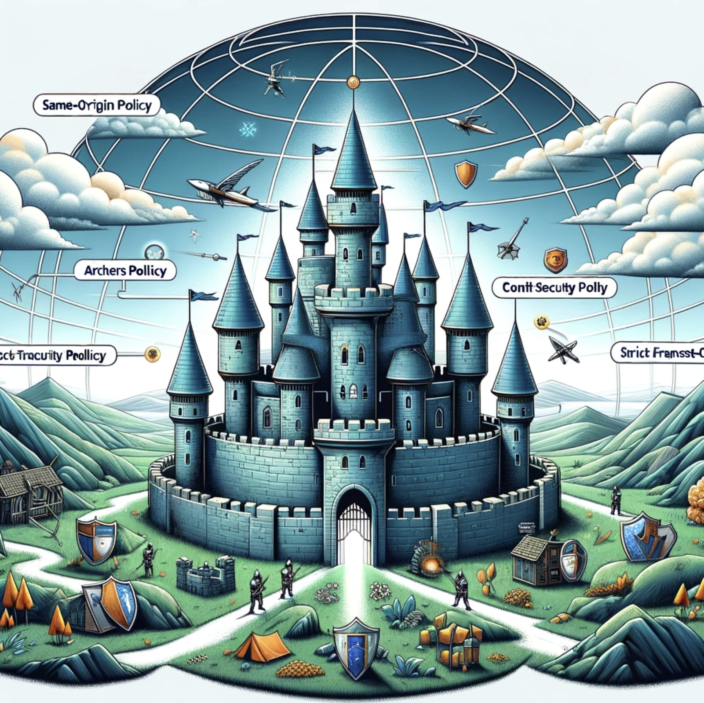
HTTP Security Headers

Slide 43
HTTP Security Headers
Tells a browser what extra rules to enforce
Protects against MITM, clickjacking, cross-site scripting, and more
Be careful!
NetEscapades.AspNetCore.SecurityHeaders

Slide 44
Resources
My talk deep diving on this topic: https://www.youtube.com/watch?v=7MWXTXjtl8s

Slide 45

Build Once, Deploy Many Times

Slide 46
Build Once, Deploy Many Times
Discourages Long Running Branches and GitFlow
Encourages Trunk Based Development (even with PRs)
Atlassian calls Gitflow “a legacy workflow”
Encourages Continuous Integration (the practice)
Environmental differences (i.e. config, secrets) live in the environment

Slide 47

ValidateOnBuild

Slide 48
ValidateOnBuild
Singletons can only depend on Singletons
The “captive dependency” problem
ASP.NET Core will catch this when running in Development but not other environments
If you have a custom local env name…

Slide 49
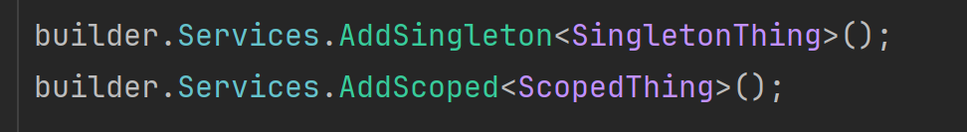
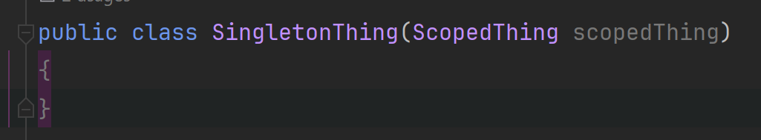
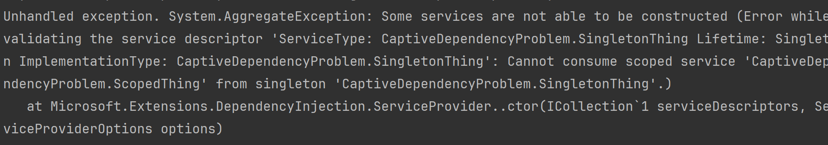
ValidateOnBuild

Slide 50
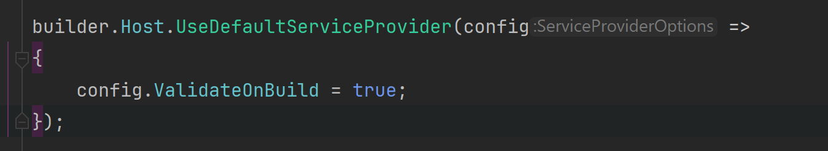
ValidateOnBuild

Slide 51
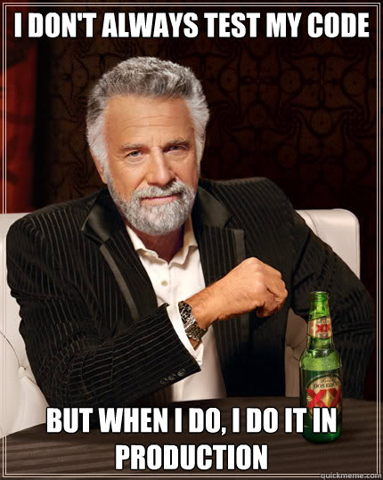
Automated Tests

Slide 52
Automated Testing with xUnit
You should be writing automated tests
Exposes holes in your architecture
Proven to be faster long-term
Make changes quickly and confidently because have a regression test suite
Use xUnit or NUnit
Just not MSTest which is wayyy more verbose and has less features
xUnit used by ASP.NET team
scottsauber

Slide 53
Problem: OOB Assertion Libraries Annoy Me
Assert.Equal(value, value)
Hard to remember that it’s Assert.Equal(expected, actual)
Yes I know analyzers are baked into xUnit to help here
Can lead to funky looking assertion failures if you flip them
scottsauber

Slide 54

Solution: Use FluentAssertions for assertions
Adds a Should() extension method to object
result.Should().Be(0);
Easier to read than Assert.Equal(0, result);
Should().BeEquivalentTo();
actualCustomer.Should().BeEquivalentTo(expectedCustomer);
327M+ downloads
scottsauber

Slide 55


Chekhov’s Gun
scottsauber

Slide 56

“Remove everything that has no relevance to the story. If you say in the first chapter that there is a rifle hanging on the wall, in the second or third chapter it absolutely must go off. If it's not going to be fired, it shouldn't be hanging there.” Anton Chekhov

Slide 57
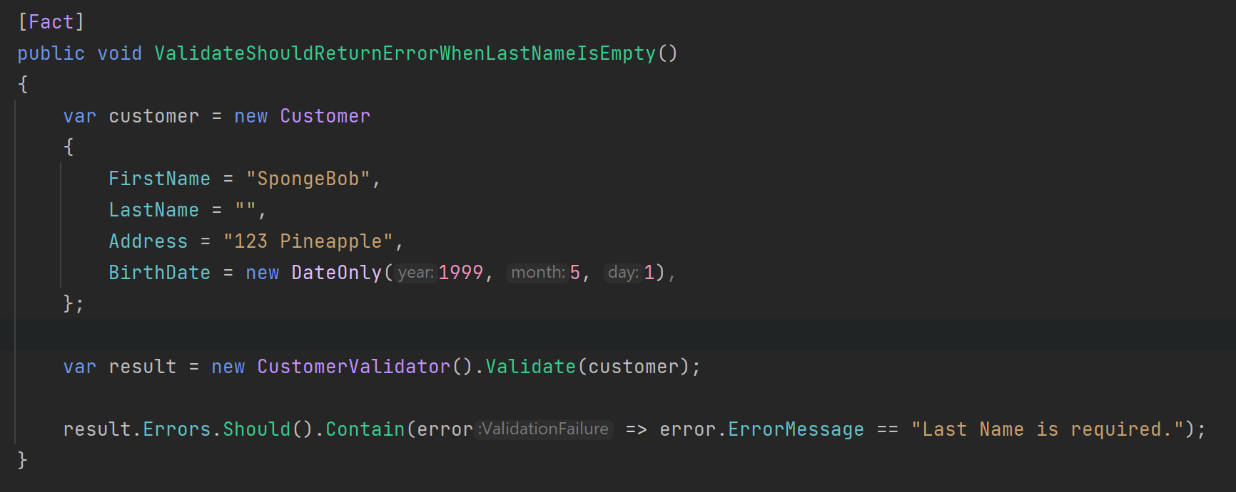
Chekhov’s Gun Applied to Testing
scottsauber

Slide 58
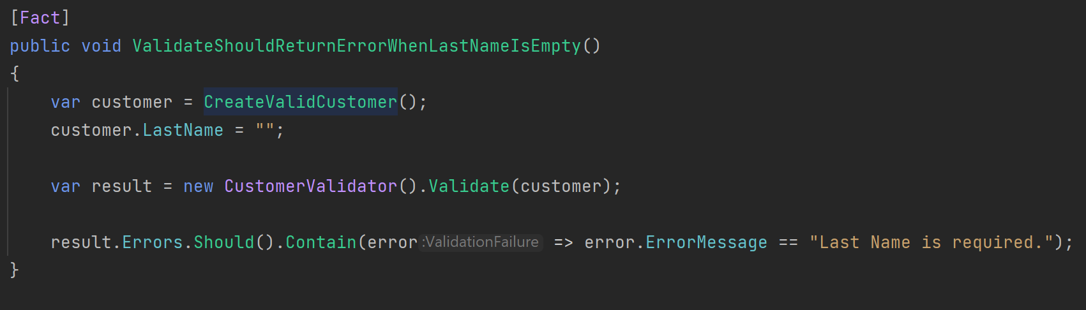
Chekhov’s Gun Applied to Testing
scottsauber

Slide 59
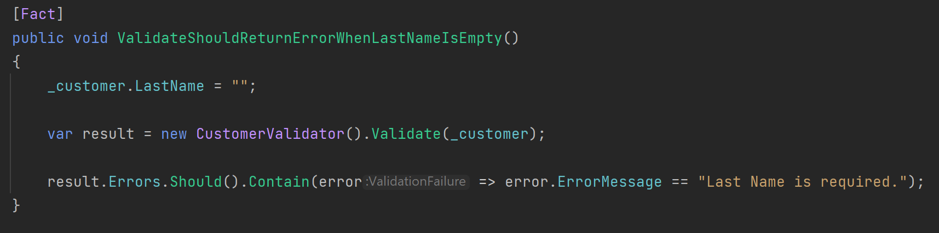
Chekhov’s Gun Applied to Testing
scottsauber

Slide 60
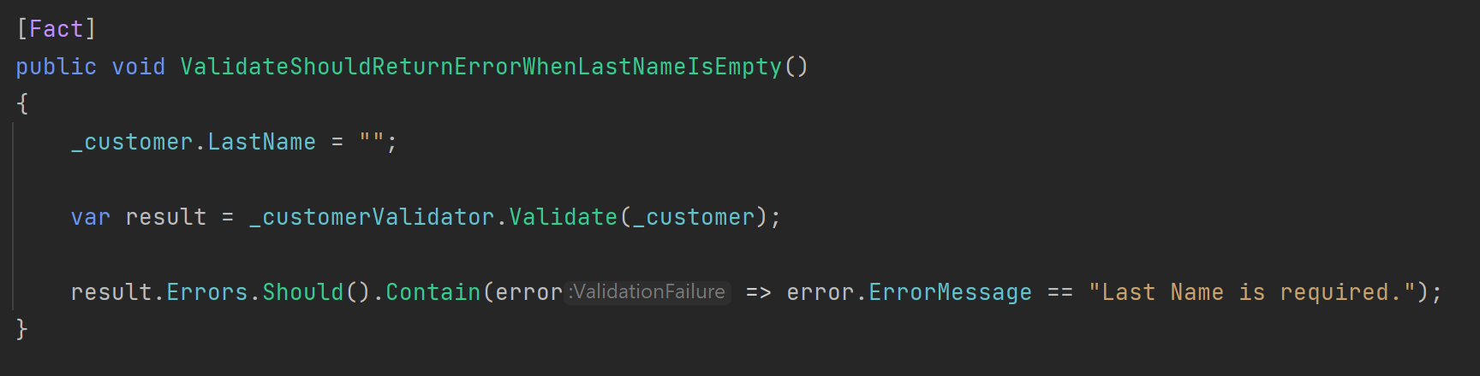
Chekhov’s Gun Applied to Testing
scottsauber

Slide 61
Chekhov’s Gun Applied to Testing
scottsauber

Slide 62

Central Package Management

Slide 63
Problem
Same package in multiple projects across your solution
Annoying to keep version in sync
Tests projects especially
I find most people don’t know Central Package Management exists
scottsauber

Slide 64
Solution: Central Package Management
Added in .NET 6
Create Directory.Packages.props at the root and define packages and versions there
Omit Version attribute in PackageReference
All packages will have to omit the Version attribute
Can override with VersionOverride attribute
scottsauber

Slide 65
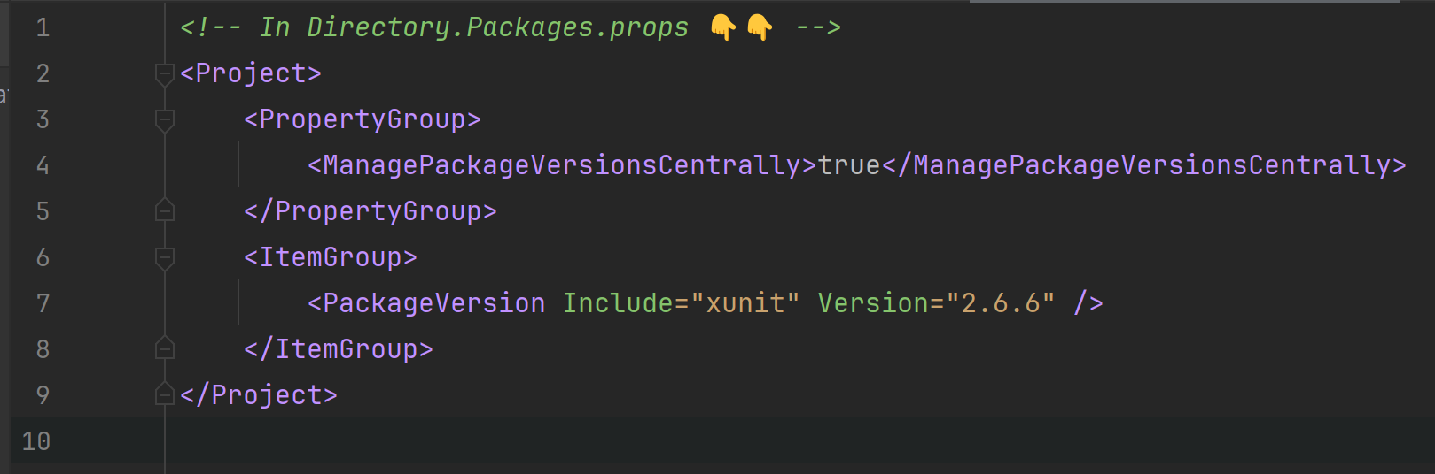
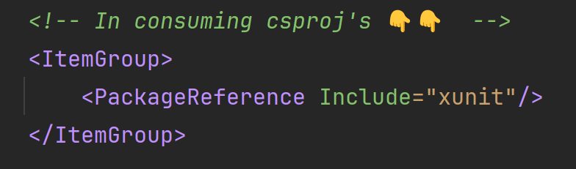
Solution: Central Package Management
scottsauber

Slide 66

BONUS

Slide 67
Ever wonder what SQL Queries EF is making?
Switch log level of Microsoft.EntityFrameworkCore.Database.Command to Information
Only do this for local development

Slide 68
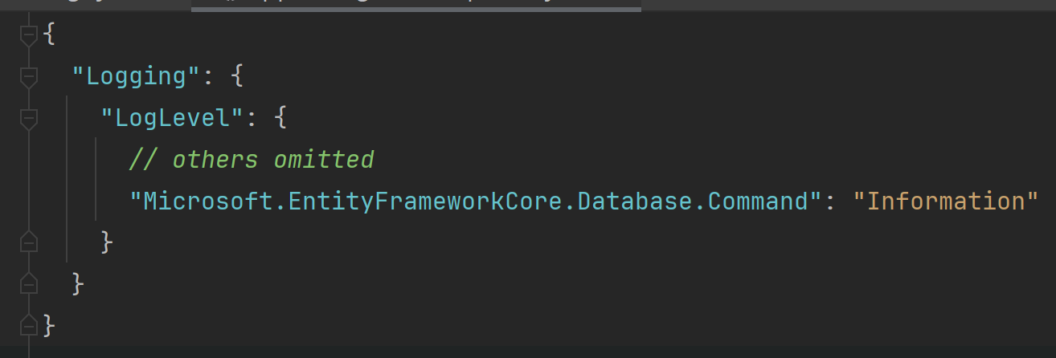
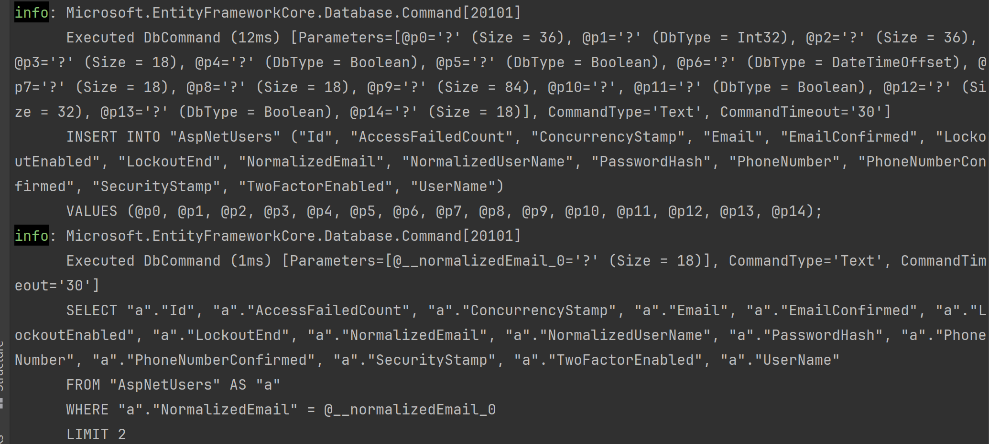
Ever wonder what SQL Queries EF is making?

Slide 69
More Bonus!
CI/CD Pipelines
Confident Green
Feature Toggles
Work in small batches
Deploy frequently (should be daily or more frequent)
Don’t split your frontend and your BFF in another repo
Don’t put your Infrastructure as Code in another repo

Slide 70
Real benefits of these practices
1 company went from deploying to Prod 12x a year (rolling back half of those) to 2000x a year (rolling back <1% of those)
Faster, more reliable delivery of value to users

Slide 71

Questions? ssauber@leantechniques.com
Slides at scottsauber.com
scottsauber

Slide 72
Thanks!
Slides at scottsauber.com
scottsauber

